Slide 1
TOURNAMENT DIRECTOR
Dan Murphy
ORIENTATION for NEW MEMBERS

Slide 2
Communications
Website: Springfieldseniorgolf.com
Email from: springfieldseniorgolf@gmail.com
Call or text if necessary (417) 849-7367

Slide 3
Schedule of Events: 16 plus 1 Bonus Event
By Laws require 8 entries
Medical issues
i. End of Year notice
ii. Request a waiver from the board.
Bonus event includes waiting list members.
i. Counts toward your participation requirement.

Slide 4
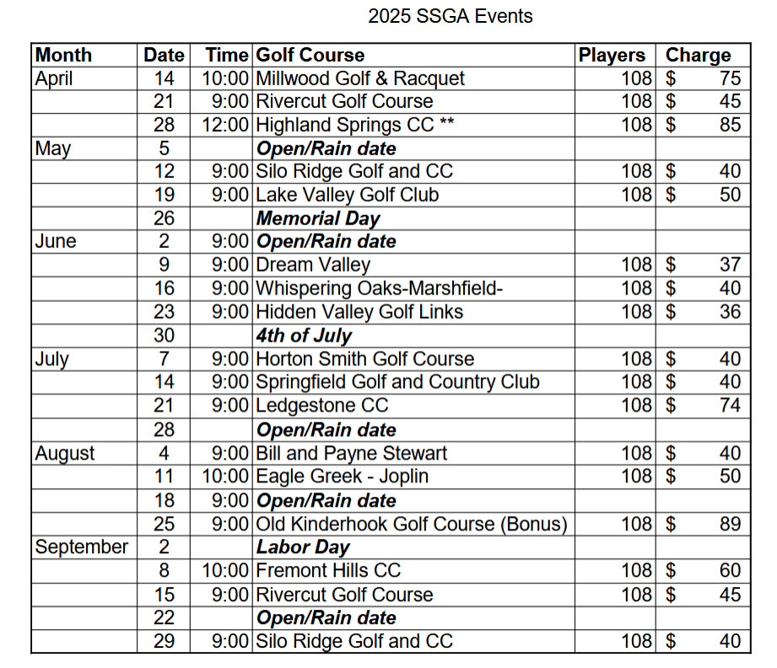

Slide 5
EVENT SIGN-UPS
Each Month on the 15th at 4:00PM for next Month.
Link automatically sent via email.
108 openings filled based on order of receipt.
Most events will be full within 15 minutes.
Anyone can sign up for you.
If you change your mind, notify the Tournament Director via email.
First Sign-up 15 March for APRIL EVENTS

Slide 6
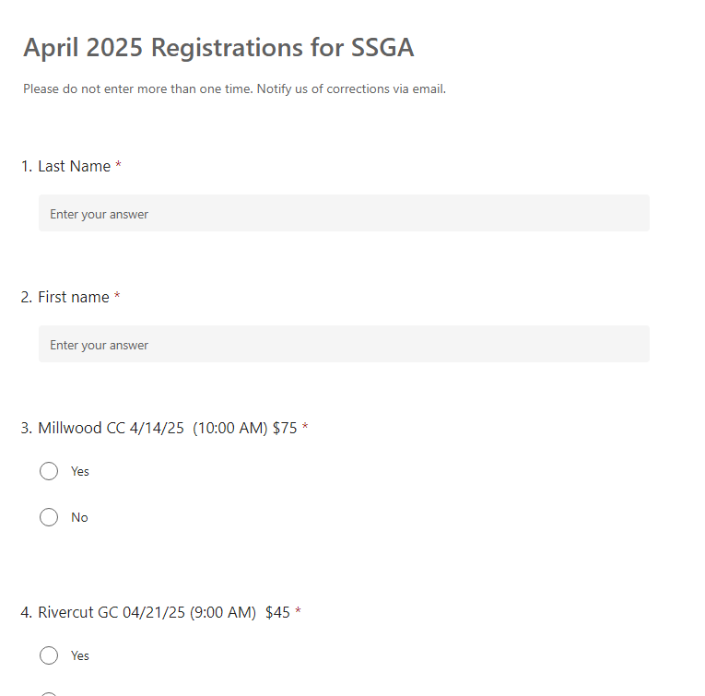

Slide 7
Waiting List
Assume you are playing unless notified otherwise that you are on the waiting list
No notice will be sent out after Sign ups.
Members on the waitlist for an event will be notified via email.
2 weeks prior to the date of the event that you are on the List.
If notified assume you are not playing unless notified that you cleared the waitlist by the Tournament Director. (Email / Text / called)
If clearing the waitlist, you must confirm via email or text. That you will play or not play.

Slide 8
DROPS
Deadline to drop without penalty is Thursday prior at noon,
If you drop out after you may be subject to paying the fee.
Drops due to medical or family issues, the fee will be waived.
If the course does not charge SSGA, you will not be charged.

Slide 9
PAIRINGS
TEAMS LIST OF MEMBER PLAYING. 4/3/2/1 Process
Notify us about anyone you want be paired or do not wish to be paired with.
Will be treated with absolute confidentiality

Slide 10
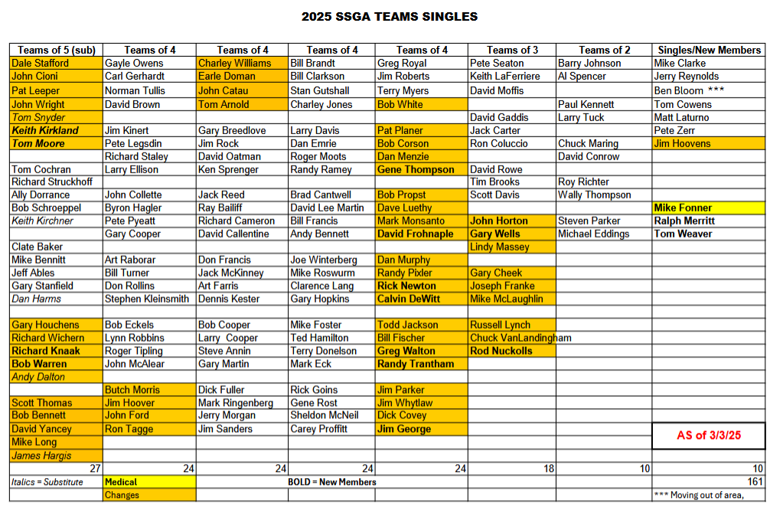

Slide 11
PARINGS FOR EACH EVENT
YOU RECEIVE THIS LIST By 8:00AM ON FRIDAY BEFORE THE SCHEDULED EVENT
Do not assume they are correct.
1. Always review even if you dropped.
2. We do make mistakes. Review to help us.

Slide 12
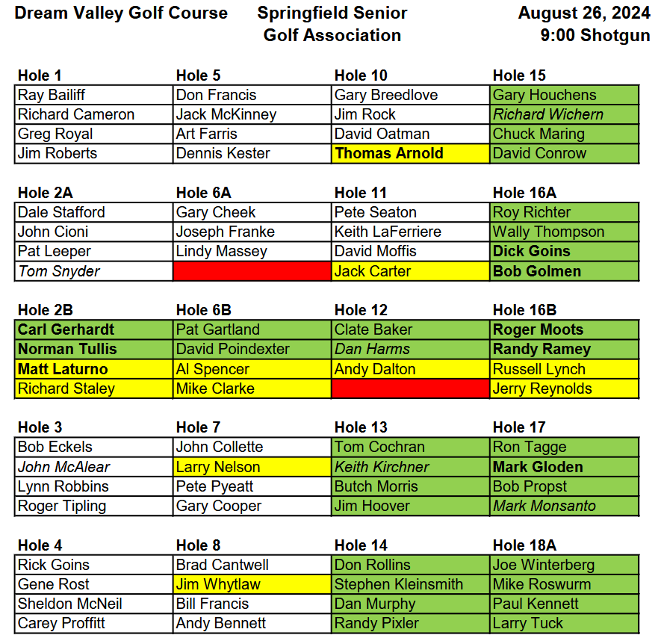

Slide 13
When You get to The Course
Find Your Cart and Load Clubs and Gear
Go to Sign in Table, Put Payment Check in Red Box and Sign up for Closes to Pin (if you like)($5) and Check your Handicap
Handicap Groups may have Different Tee Boxes
If the Course Has a Practice Range available, Range Balls are usually provided.

Slide 14
Special Rules for Events
2 Putts Maximum.
Cart Path only or Impending / Current Weather Dictates
All Other Rules on Web Site
Please Review before you Play
Pace of Play (Keep up/ Play ready Golf)

Slide 15
Cart Path Only.
At the discretion of the Golf Course. (Wx decision < 7:00AM)
If you are unwilling or unable to play, notify us.
We will attempt to get your fee waived. No guarantees.

Slide 16
Prizes
1 Sleeve of Golf Balls for flight prizes.
1st, 2nd and 3rd for both Gross and Net in 5 Flights.
Cash for Closest to the pin
3 winners per hole

Slide 17
PAYMENT
Bring your checks and put it in the Red Box at the Sign-in Table.
If you forgot your check, you cannot play until you are current.

Slide 18
When You End Your Round
Bring your Scores to the Sign-in Table and Post in the Handicap Book. (One in the Foursome can do it)

Slide 19
Communications
Website: Springfieldseniorgolf.com
Email from: springfieldseniorgolf@gmail.com
Call or text if necessary (417) 849-7367

